Slide 1
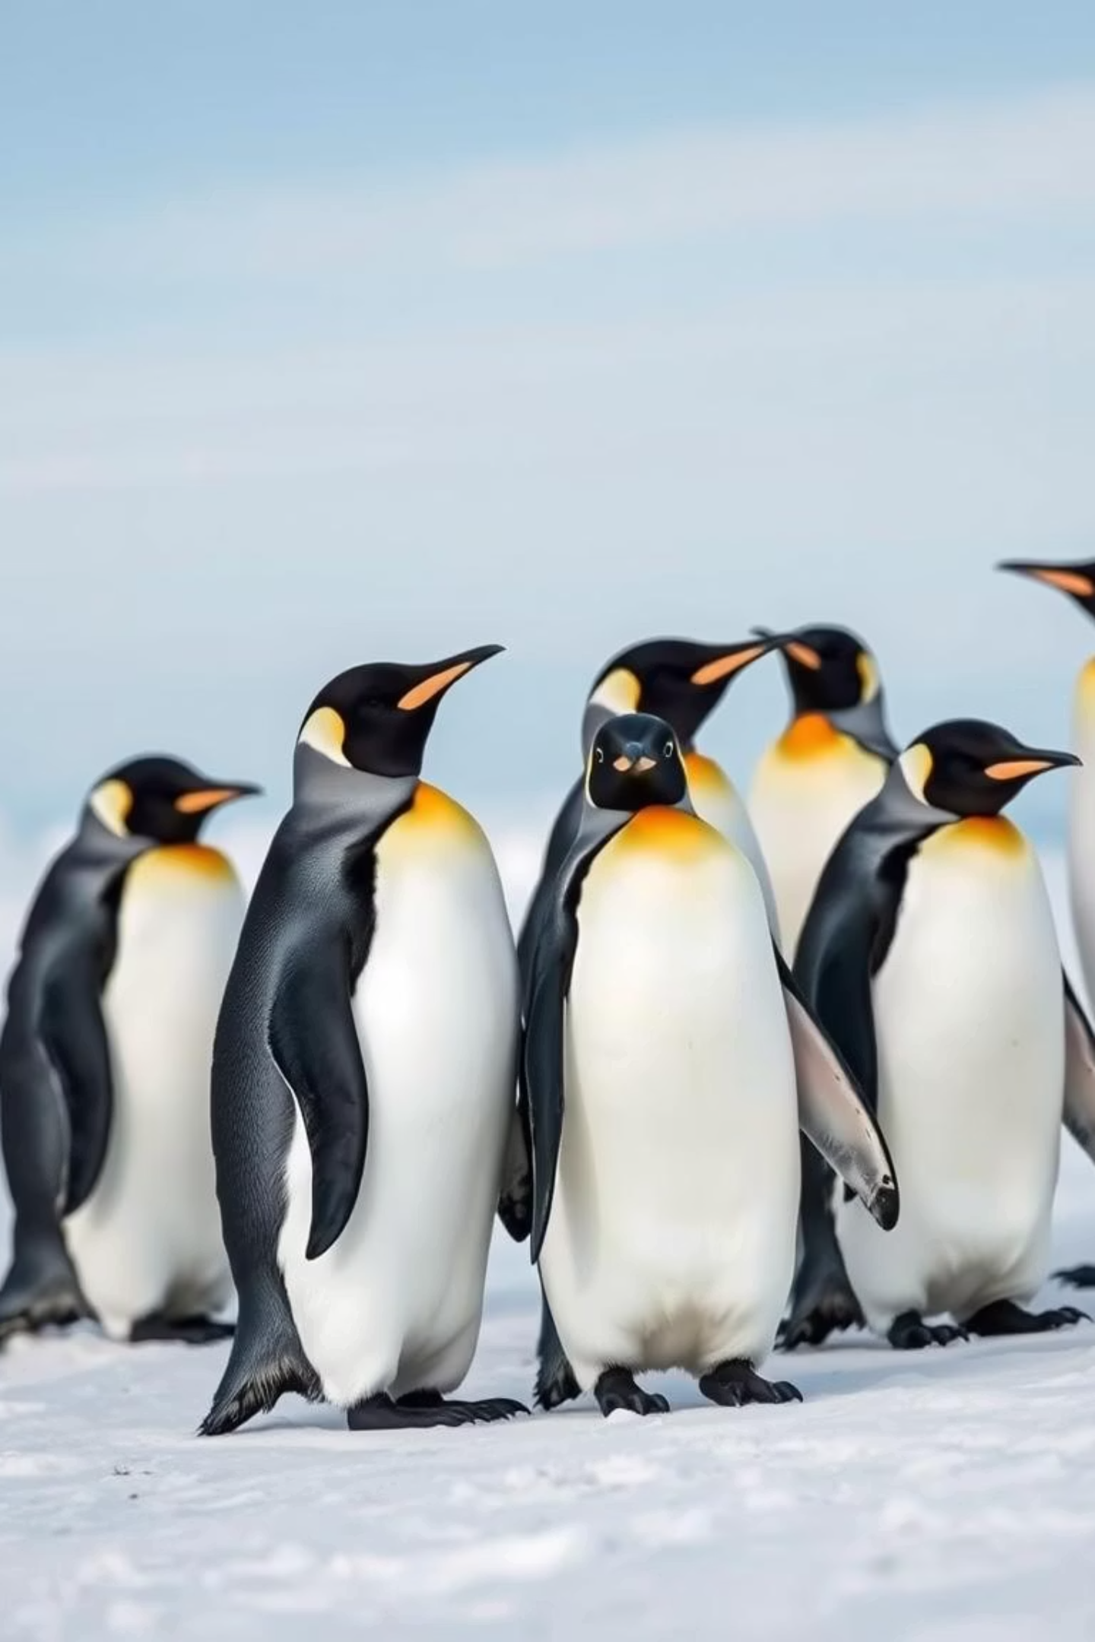

Penguin Classification Using CNN
Using the Palmer Penguins Dataset
by Adon banker

Slide 2
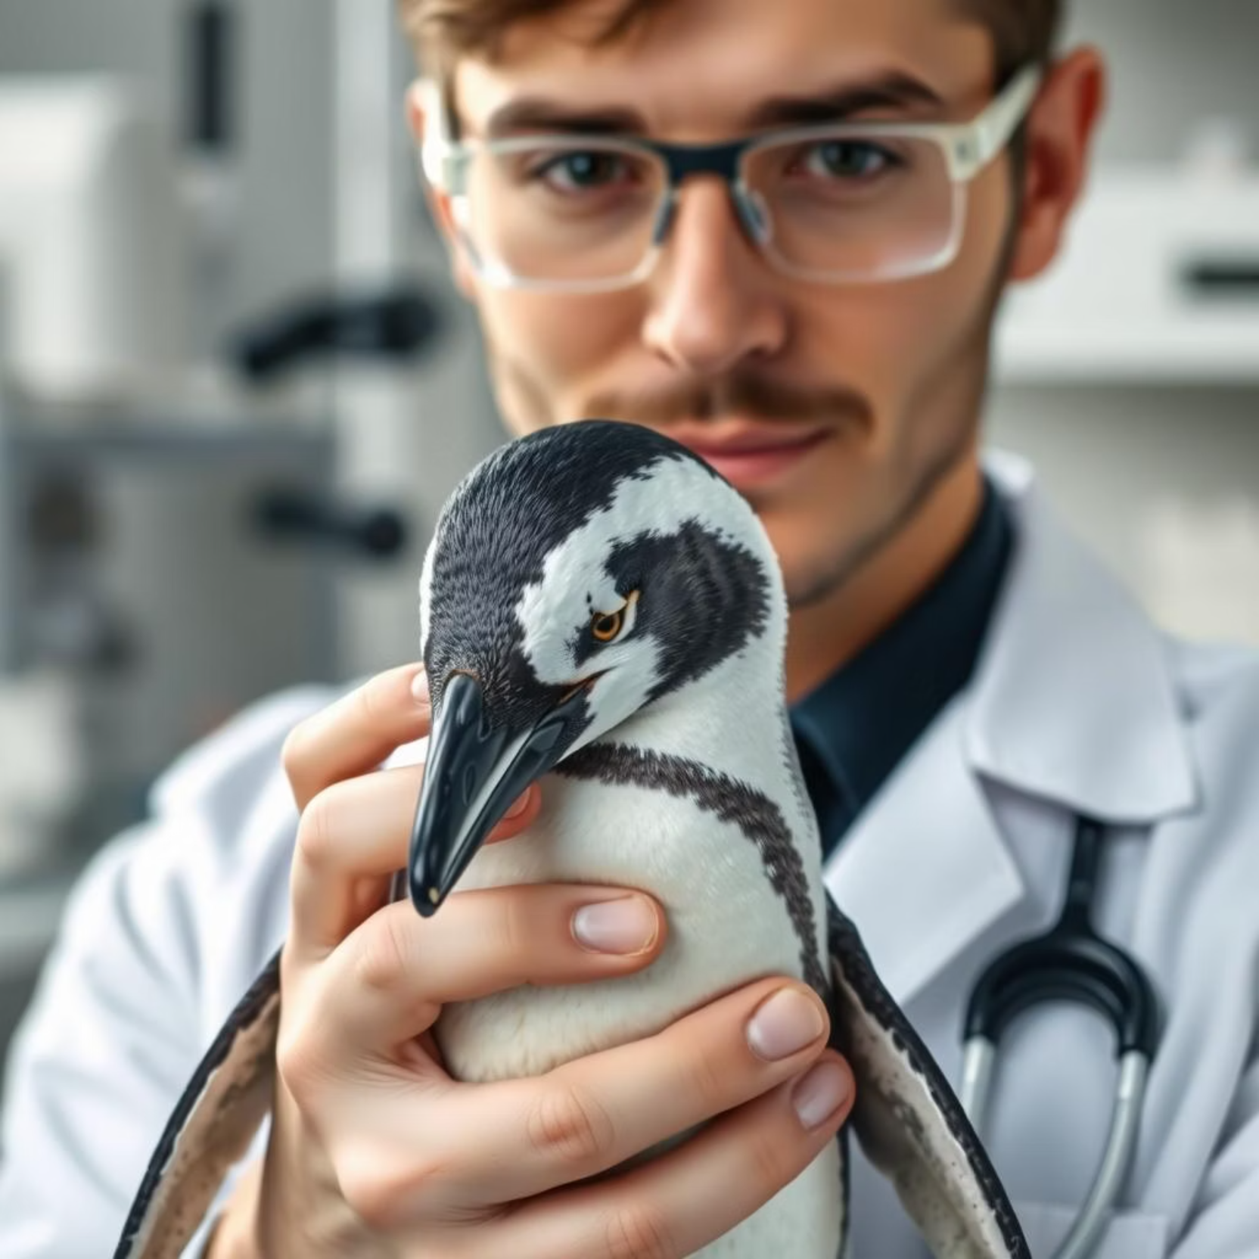
The Palmer Penguins Dataset
The Palmer Penguins dataset is a well-known resource for machine learning, providing detailed measurements for various penguin species.
344 samples: Each representing an individual penguin.
7 features: Including bill length, flipper length, body mass, sex, and island of origin.
3 target species: Adelie, Chinstrap, and Gentoo.

Slide 3

Problem Statement: Predicting Penguin Species
Our primary goal is to accurately predict the species of a penguin using its physical characteristics. This is achieved by leveraging deep learning techniques, specifically Convolutional Neural Networks (CNNs).
Goal: Predict Penguin Species
Utilize advanced deep learning models to classify penguin species based on their unique features.
Method: Deep Learning
Employ a CNN architecture tailored for structured tabular data, demonstrating its versatility beyond image recognition.

Slide 4





CNN Architecture for Tabular Data
Conv2D Layers
Initial layers to extract abstract features from the reshaped input.
MaxPooling
Reduces dimensionality, preserving essential information.
Flatten Layer
Transforms 2D feature maps into a 1D vector for Dense layers.
Dense Layers
Fully connected layers for final classification.
Softmax Activation
Outputs probabilities for each penguin species.

Slide 5
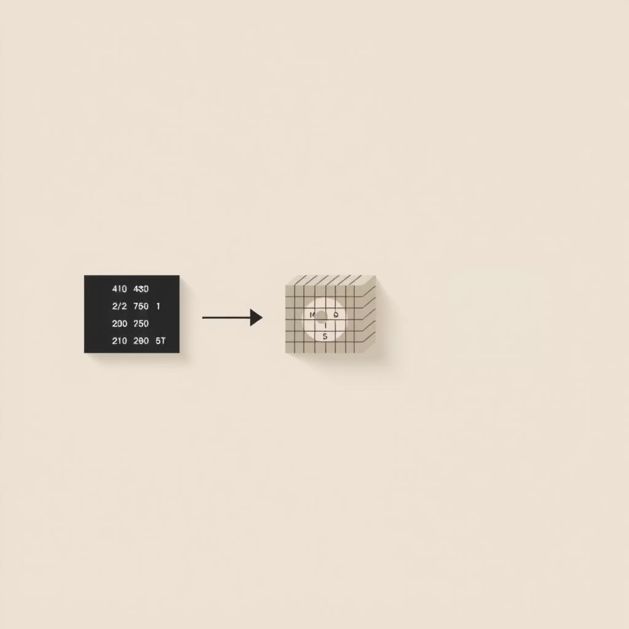
Creative Reshaping: Tabular to Image-like Input
A key innovation in this approach is the reshaping of tabular data into a format suitable for CNN processing.
Input Reshaped to (2, 3, 1)
Our 7 features are creatively arranged into a 2x3x1 "image" structure.
Mimicking Image Data
This transformation allows the CNN to apply its powerful pattern recognition capabilities.

Slide 6
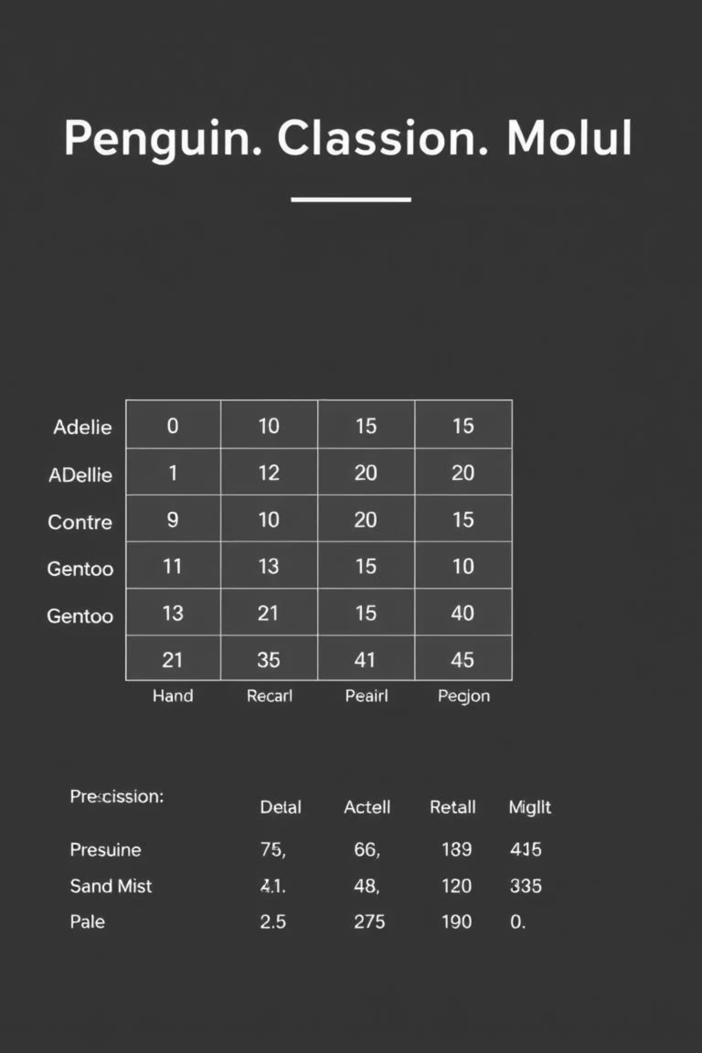
Exceptional Training Results
The model achieved impressive results, demonstrating the effectiveness of CNNs on this unique tabular dataset.
98%
Accuracy
Overall accuracy across all penguin species.

Slide 7
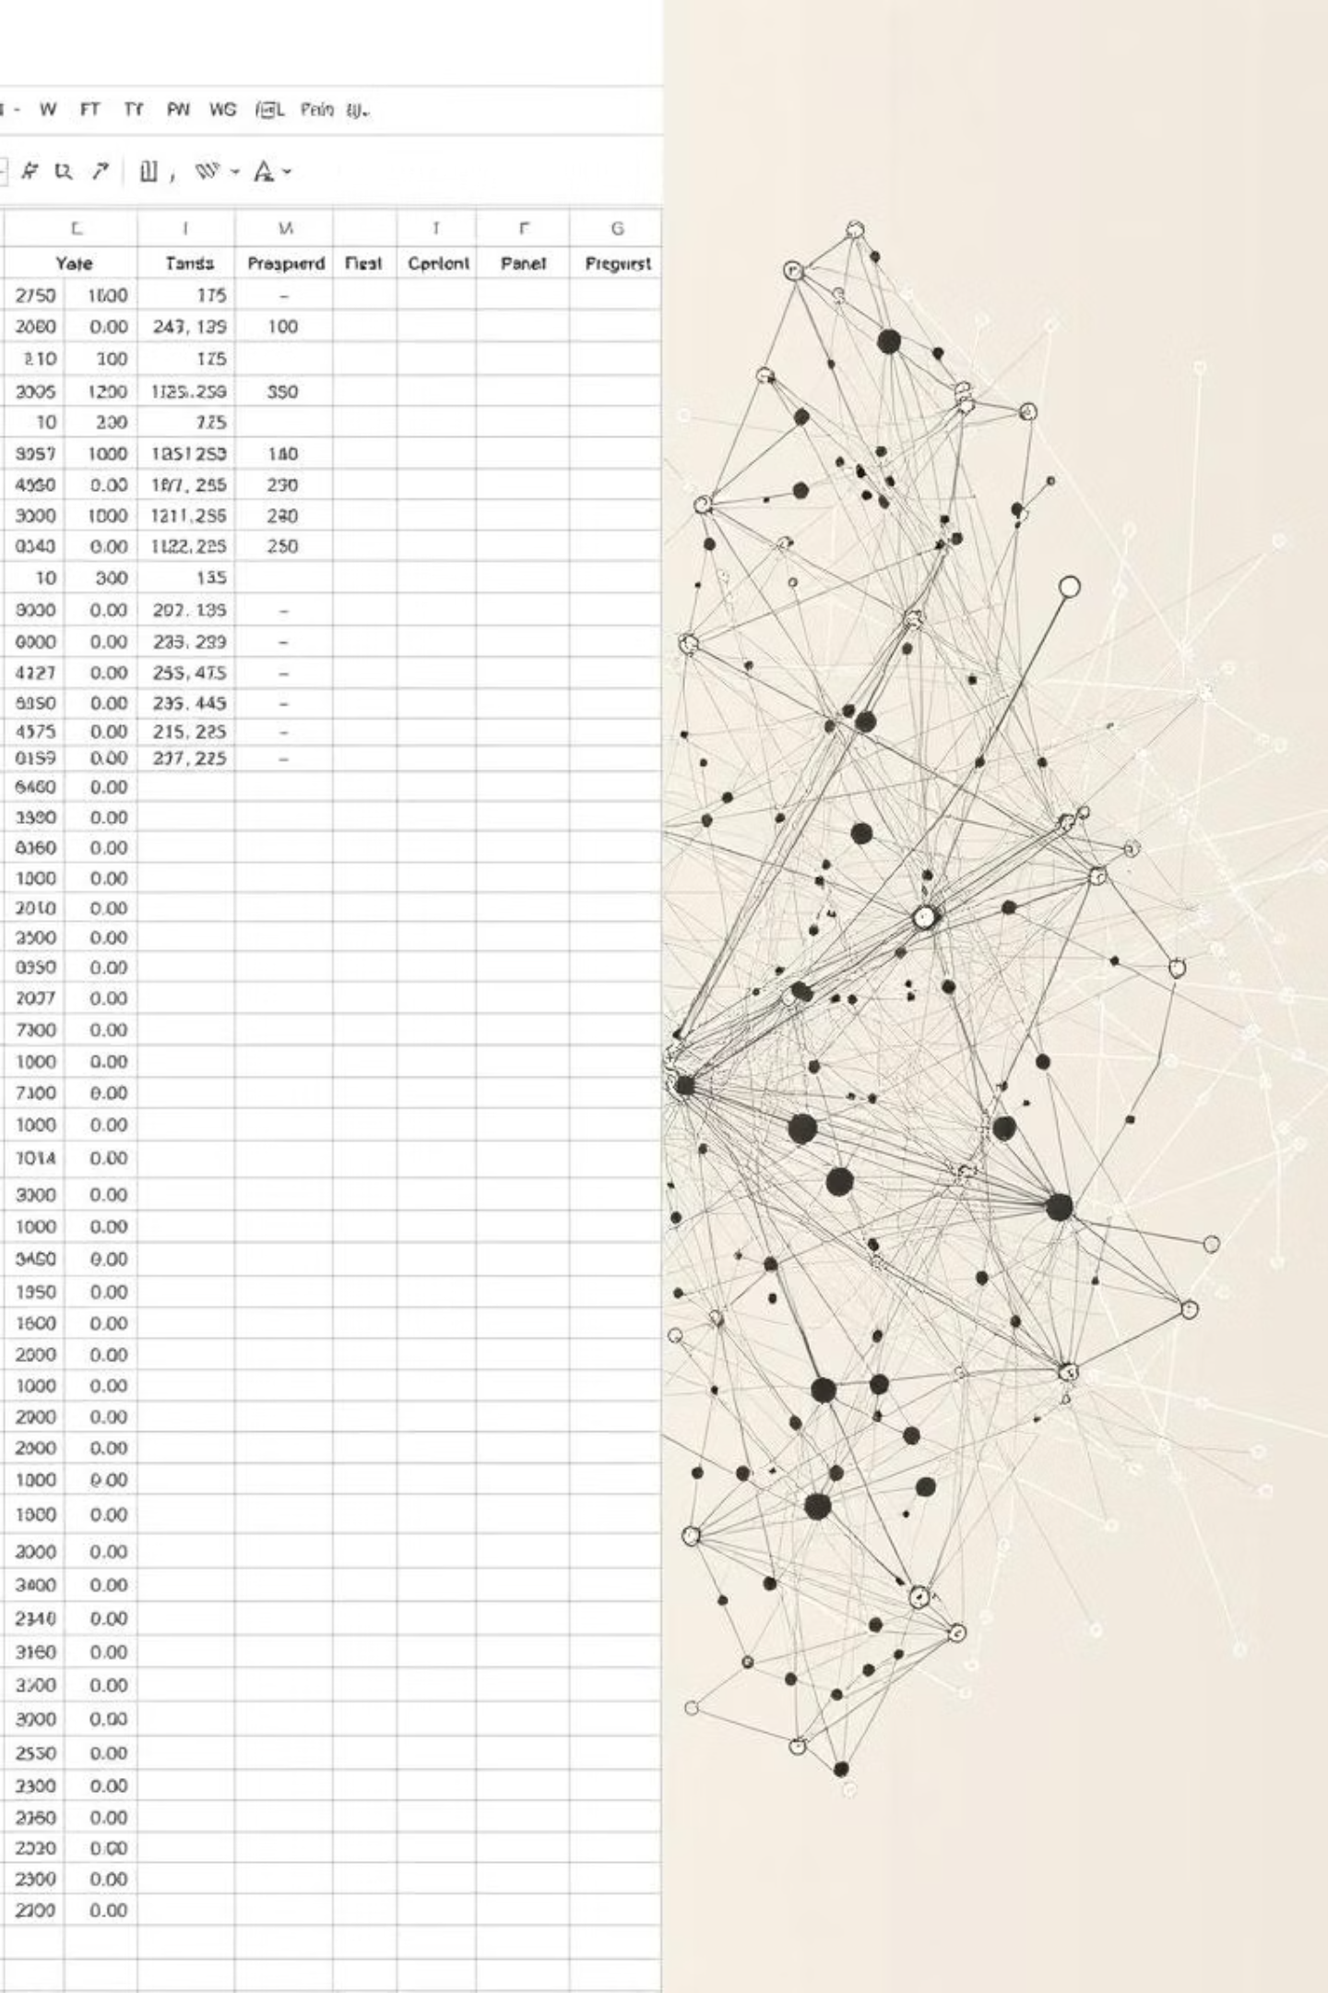



Why CNNs for Tabular Data?
Captures Local Feature Patterns
Even in reshaped tabular data, CNNs can identify subtle relationships between features.
Creative Reshaping Benefits
Transforms linear data into a grid, enabling convolutional filters to scan for patterns.
Robust Feature Extraction
CNNs excel at automatically learning relevant features, reducing the need for manual feature engineering.

Slide 8

Conclusion and Future Potential
CNNs Beyond Images
This study demonstrates the powerful applicability of CNNs to non-image, tabular datasets.
Accurate & Flexible Model
The resulting model is highly accurate and adaptable for various classification tasks.
Deeper Tuning Potential
Further optimization of hyperparameters and architectures could yield even higher performance.

